Slide 1

Record Linkage in Historical Records of Barcelona
- Bhaskar Gautam

Slide 2
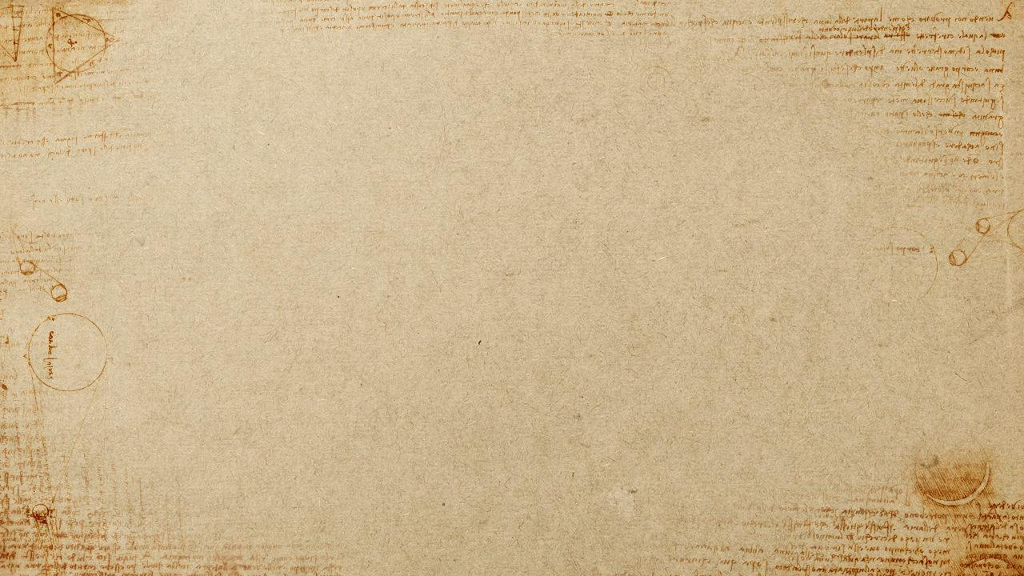
Introduction
Record Linkage
Record Linkage is the task of finding records in a data set that refer to the same entity across different data sources.
Other common terms used for the task:
Data matching
Deduplication
Object identification.
Entity Alignment
Entity Alignment aims to predict a link or relation between two entities from the same or different knowledge graphs.
Other common terms used for the task:
Ontology alignment
Link Prediction
Author Disambiguation.
Python Code available at: https://github.com/bhaskargautam/record-linkage
Objective: Link two Records from different census years corresponding to a same individual.

Slide 3
Outline
Entity Alignment Methods
Experiments
Data sets
Record Linkage Methods
Proposed Methods

Slide 4
Data Sets
Historical census data of Sant Feliu
59, 084 records in 16 census years
FEBRL synthetic biomedical data
5, 000 original + 5, 000 duplicates
Cora bibliographical data
1, 879 citations for 191 unique papers

Slide 5
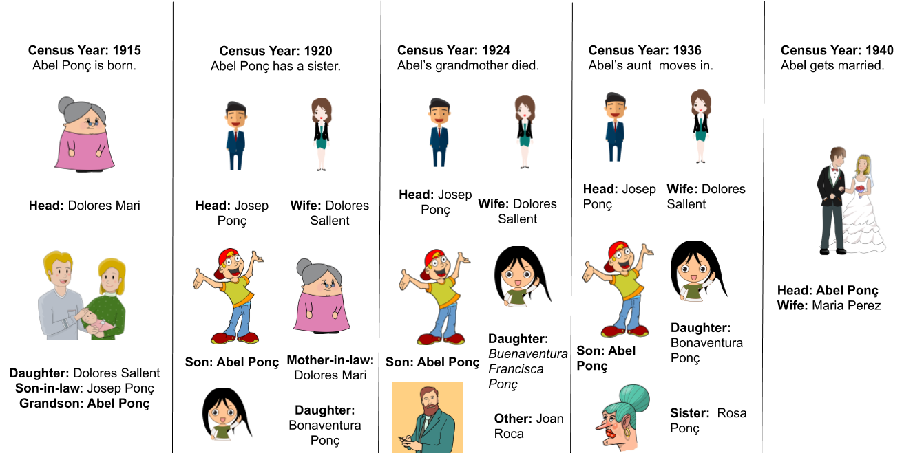
Hello!
Family history of Abel Ponç

Slide 6
Outline
Entity Alignment Methods
Experiments
Data sets
Record Linkage Methods
Proposed Methods

Slide 7
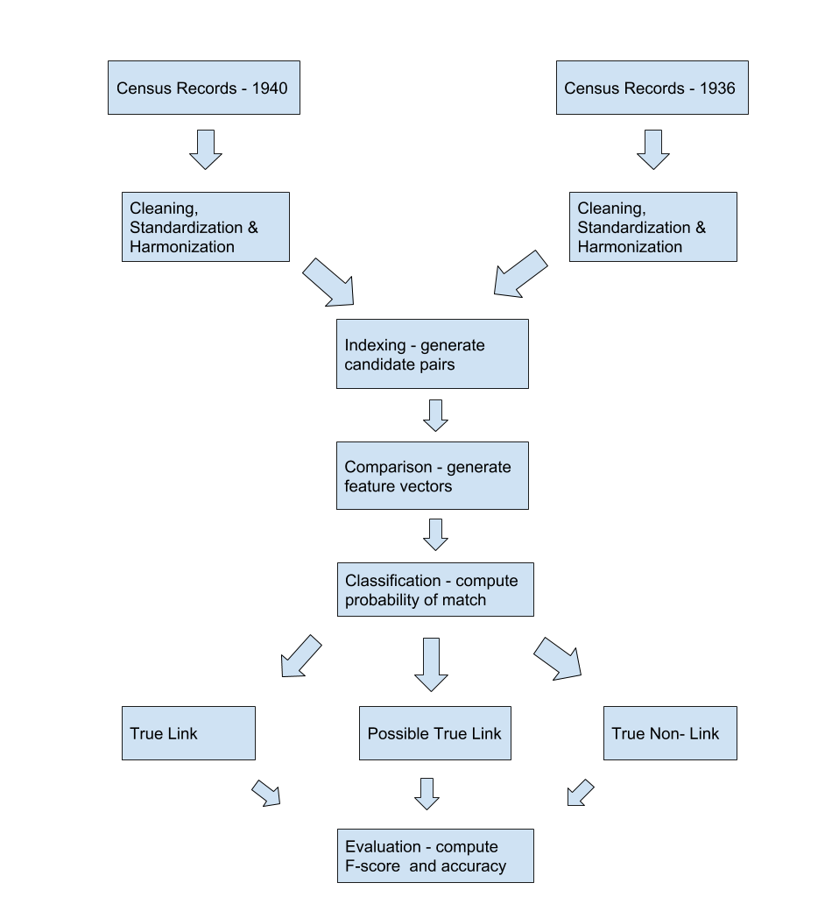
Fellegi And Sunter Framework
Seminal paper in 1969
Formulates record linkage problem as a binary classification problem.
Provides optimal linkage rule by estimating probability of match i.e. P(m=1 | (a, b)).

Slide 8
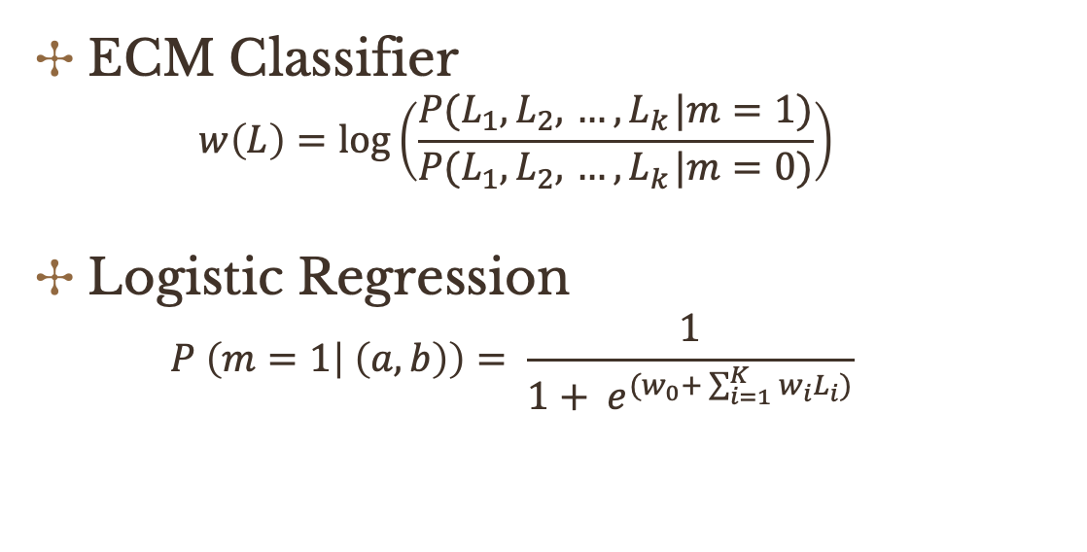
Classification Methods
ECM Classifier
$$w\left(L\right)=log⁡\left(\frac{P(L_{1},L_{2},{ …, L}_{k}|m=1)}{P(L_{1},L_{2},{ …, L}_{k}|m=0)}\right)$$
Logistic Regression
$$P \left(m=1 | \left(a,b\right)\right)= \frac{1}{1+ e^{(w_{0}+ \sum_{i=1}^{K}{w_{i}L_{i}})}}$$

Slide 9
Outline
Entity Alignment Methods
Experiments
Data sets
Record Linkage Methods
Proposed Methods

Slide 10
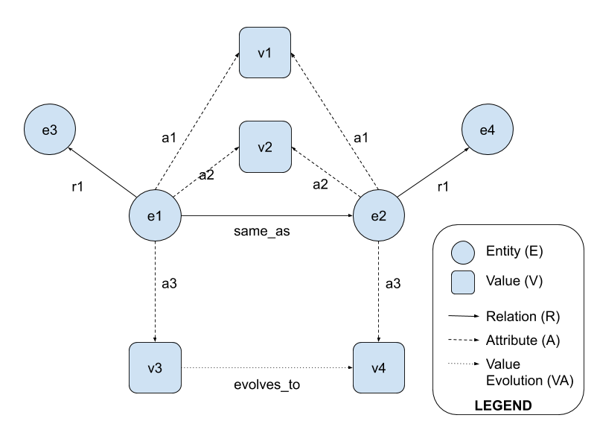
Knowledge Graph
Represents a collection of interlinked descriptions of entities – real-world objects, events, situations or abstract concepts in a formal structure.
Popular knowledge graphs include Freebase, DBpedia, YAGO, Satori, etc.

Slide 11
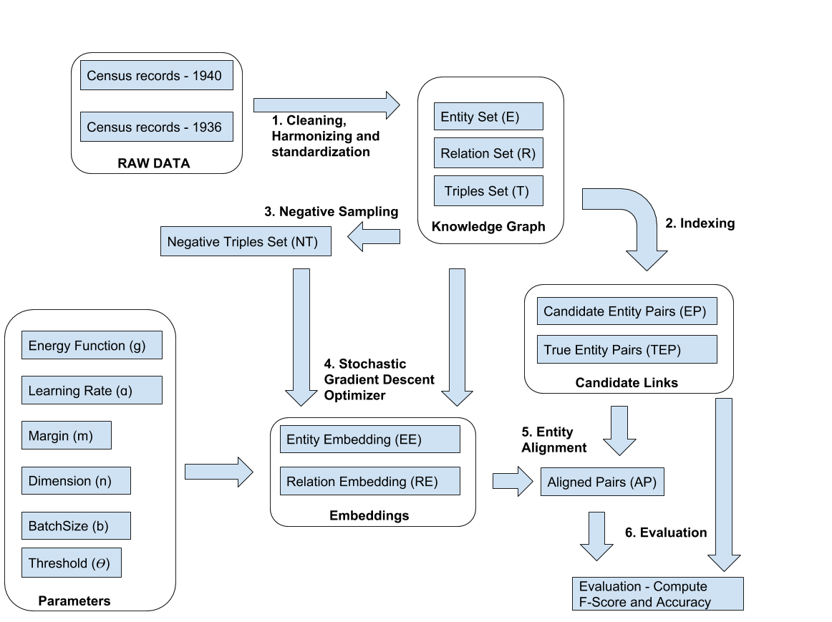
Entity Alignment Workflow
Projects entities and relations to n-dimensional vector space.
Computes cosine distance between entities to align.

Slide 12
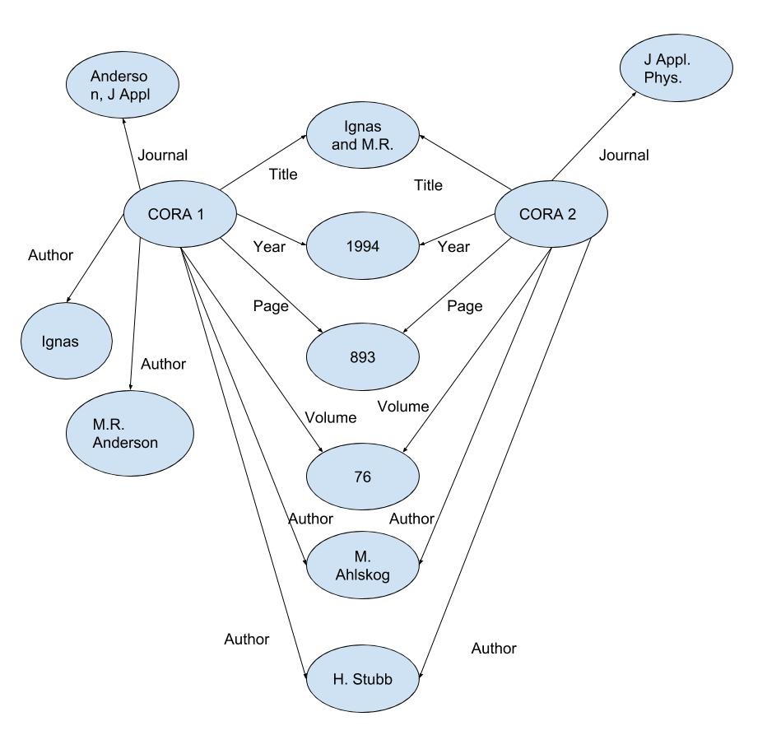
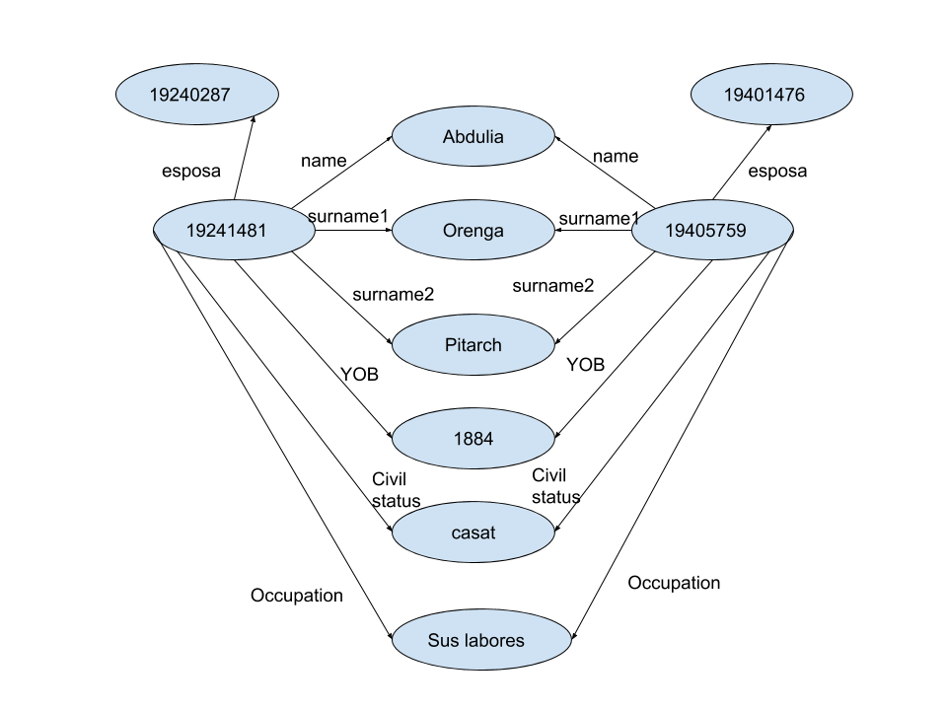
Entity – Relation Graph
Census Dataset
Cora Dataset

Slide 13
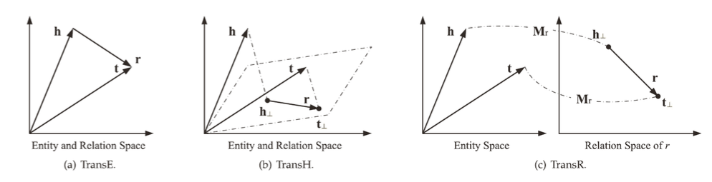
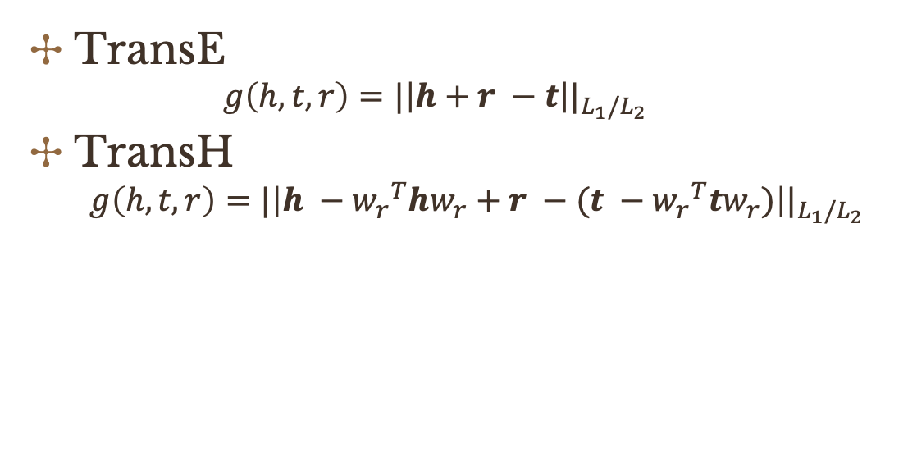
Energy Function
TransE
$$g\left(h, t, r\right)={|\left|h+r −t\right||}_{L_{1}/L_{2}}$$
TransH
$$g\left(h, t, r\right)={|\left|h −{w_{r}}^{T}hw_{r}+r −(t −{w_{r}}^{T}tw_{r})\right||}_{L_{1}/L_{2}}$$

Slide 14
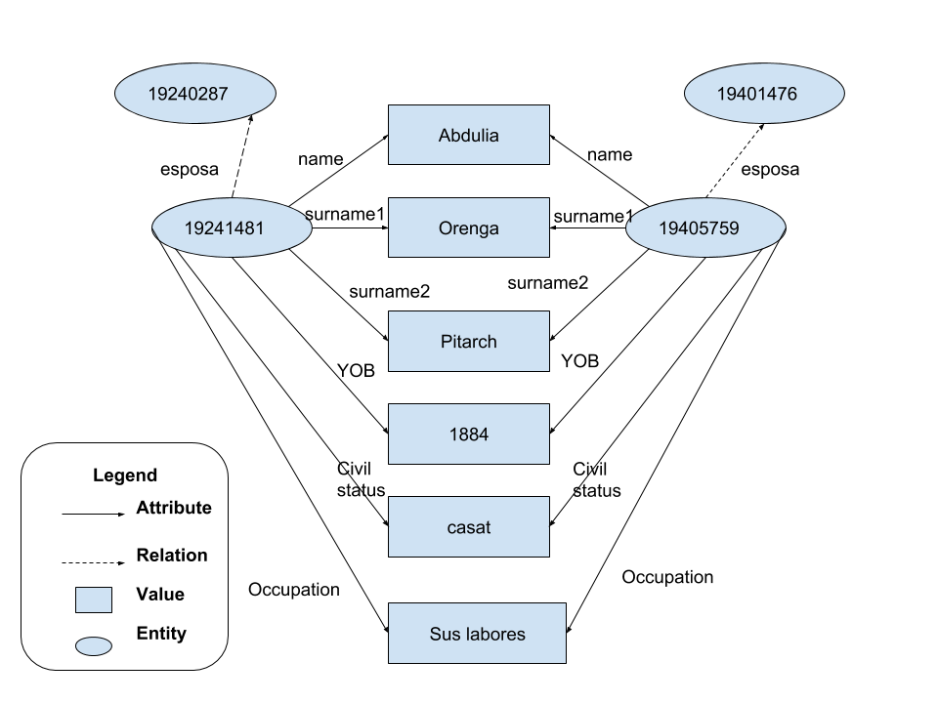
Entity – Attribute – Relation
One-to-many and many-to-many relations considered as attributes.
KR-EAR projects attributes and relations to different vector spaces.
SEEA employs self-learning to update embedding iteratively.

Slide 15
Outline
Entity Alignment Methods
Experiments
Data sets
Record Linkage Methods
Proposed Methods

Slide 16
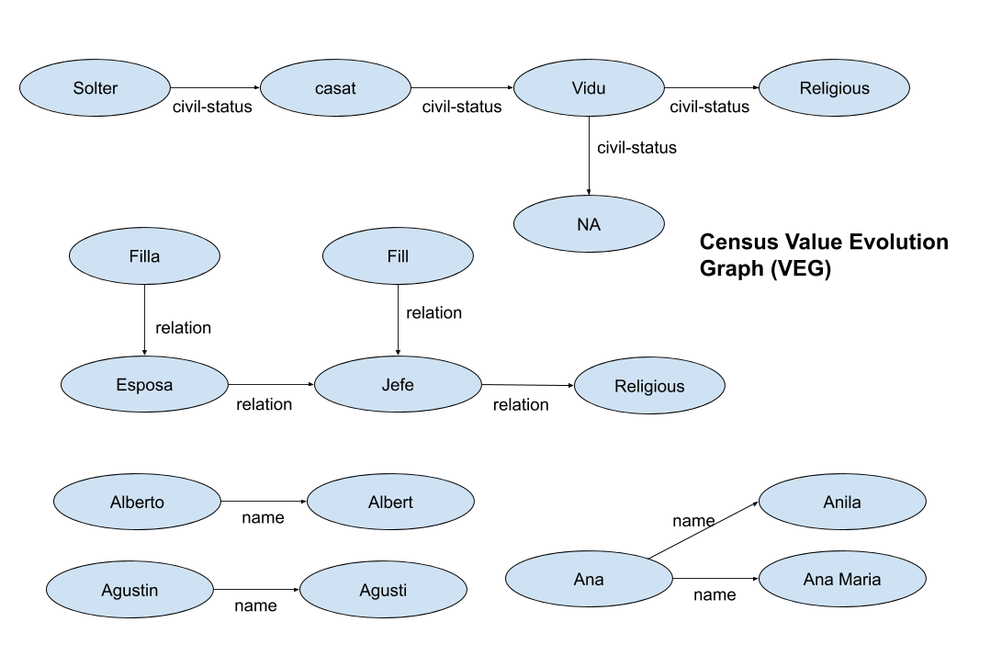
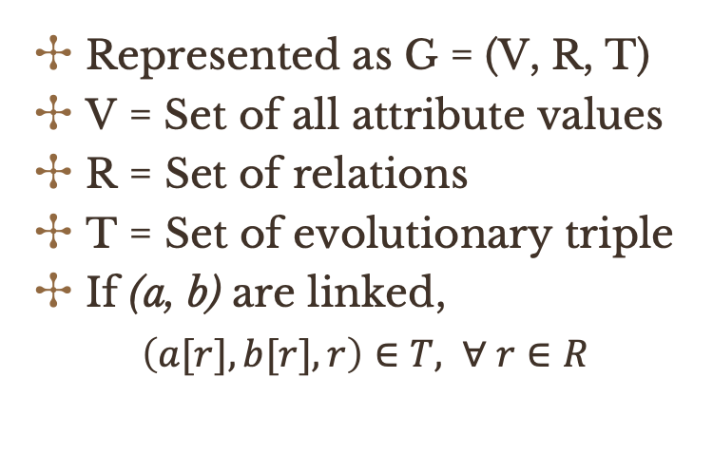
Value Evolution Graph
Represented as G = (V, R, T)
V = Set of all attribute values
R = Set of relations
T = Set of evolutionary triple
If (a, b) are linked,
$\left(a[r],b[r], r\right)∈T, ∀ r∈R$

Slide 17
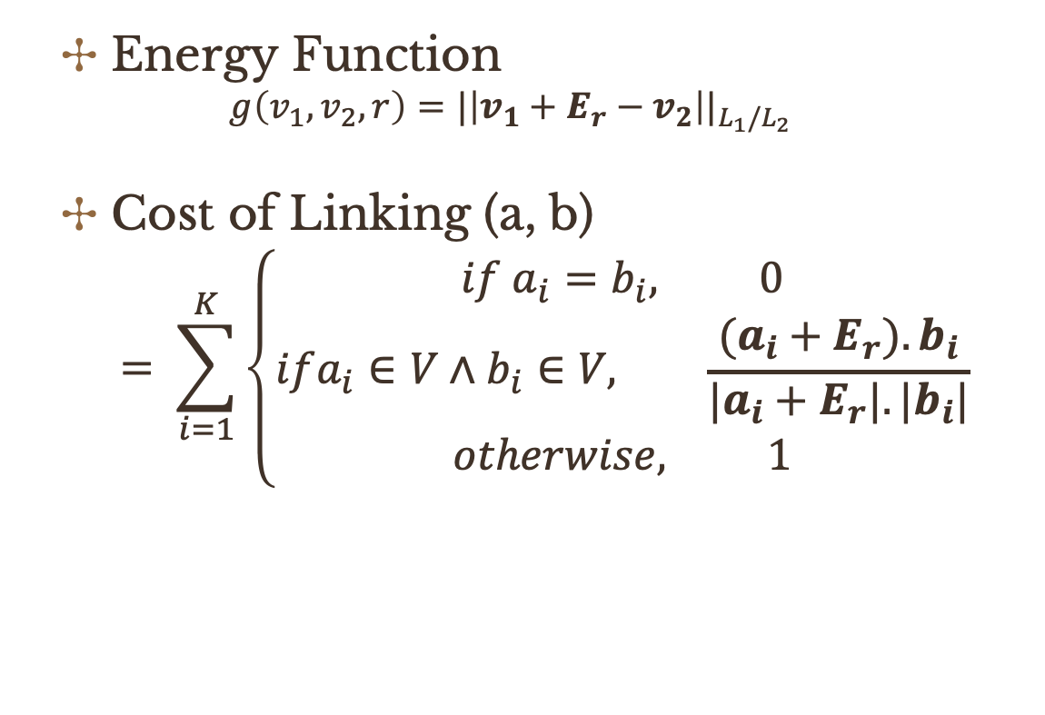
RL-TransE
Energy Function
$$g\left(v_{1},v_{2}, r\right)={|\left|v_{1}+E_{r}−v_{2}\right||}_{L_{1}/L_{2}}$$
Cost of Linking (a, b)
$$= \sum_{i=1}^{K}{\left\{\begin{aligned}if a_{i}=b_{i}, 0 \\ ifa_{i}∈V∧&b_{i}∈V, \frac{{(a}_{i} +{ E}_{r}).b_{i}}{{{|a}_{i}+E_{r}|.|b}_{i}|} \\ otherwise, 1\end{aligned}\right.}$$

Slide 18
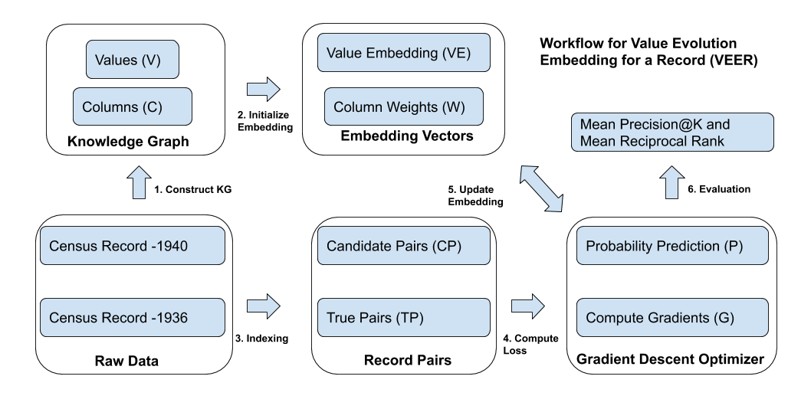
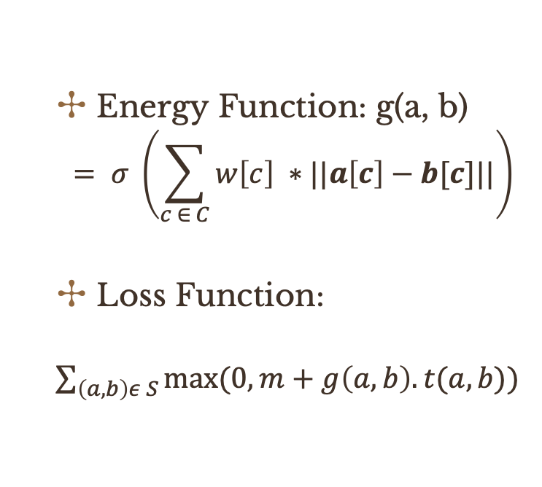
VEER
Energy Function: g(a, b)
$$= σ \left(\sum_{c ∈ C}{w\left[c\right] ∗||a\left[c\right]−b[c]||}\right)$$
Loss Function:
$\sum_{\left(a, b\right)ε S}{max⁡(0, m+g\left(a,b\right).t(a,b))}$

Slide 19
Outline
Entity Alignment Methods
Experiments
Data sets
Record Linkage Methods
Proposed Methods

Slide 20
Data Partition
 | Training | Validation | Test
Dataset A | 9, 510 | 10, 629 | 9, 384
Dataset B | 10, 629 | 10, 536 | 10, 722
Candidate Pairs | 238, 854 | 244, 696 | 240, 954
True Pairs | 6, 748 | 8, 412 | 9, 049

Slide 21
Statistical Analysis
 | Accuracy | Precision | Recall | F-Score
ECM | 0.99 | 0.98 | 0.99 | 0.98
Log. Reg. | 0.99 | 0.98 | 0.98 | 0.98
TransE | 0.87 | 0.19 | 0.25 | 0.21
RL-TransE | 0.99 | 0.97 | 0.92 | 0.95
VEER | 0.99 | 0.98 | 0.92 | 0.95

Slide 22
Information Retrieval
 | MP@1 | MP@10 | MRR | MAP
ECM | 0.99 | 0.10 | 0.99 | 0.99
Log. Reg. | 0.99 | 0.10 | 0.99 | 0.99
TransE | 0.35 | 0.09 | 0.51 | 0.51
RL-TransE | 0.99 | 0.15 | 0.99 | 0.99
VEER | 0.99 | 0.15 | 0.99 | 0.99

Slide 23
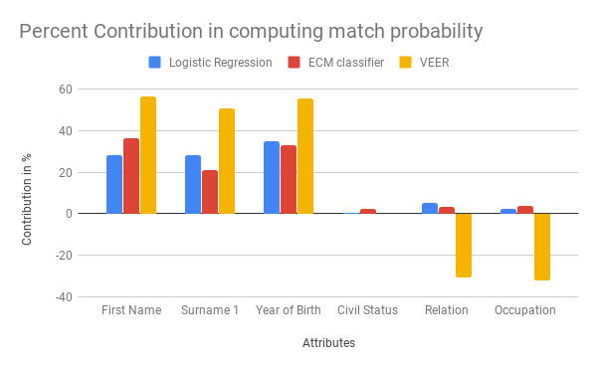
Conclusion
VEER and RL-TransE are able to learn valid /invalid value evolutions.
VEER capable of penalizing probability of mismatch.

Slide 24
Acknowledgement
Special thanks to :
Dr. Oriol Ramos Terrades
Computer Vision Center (CVC)
Centre of Demographic Studies (CED),
Document Analysis Group(DAG)
Spanish grant RTI2018-095645-B-C21
Xarxes project and Nvidia
Presentation template by SlidesCarnival

